Slide 1
SUPERVISED LEARNING (TASK 1)
By Anvesha Gupta (25EX10017)
To KodeinKGP, IIT Kharagpur

Slide 2
Introduction
My name is Anvesha Gupta (25EX10017). I am a 1st year student of the department of Geology and Geophysics enrolled in it’s bachelor of science course of Exploration Geophysics. I am a boarder of Sister Nivedita Hall of Residence. I am from Bangalore.
This presentation has been made based on the 1st article of task-1 (Supervised Learning : A Comprehensive Guide).

Slide 3



Machine Learning
Machine Learning (ML) is a branch that deals with making systems that learn from data and make themselves better over time rather than having a fixed code or algorithm. A machine learning model analyses relationships in given data to make accurate predictions about given inputs.
Types of Machine Learning
Supervised learning
Trained on a labelled dataset containing input-output pairs
Learns rules and mapping between given features and labels
Ex: Classification and regression
Un-Supervised learning
Works with unlabelled data
Identify hidden groupings and connections within the dataset
Ex : Clustering , Association
Reinforcement learning
Involves teaching agents to make a series of choices
Provides rewards for correct actions and penalties for incorrect ones
Helps improve decision-making process over time
Ex : Gaming, Robot navigation

Slide 4
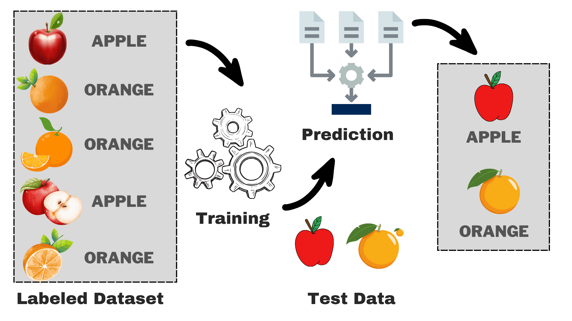
What is Supervised Learning?
Supervised learning is a type of machine learning in which an algorithm is trained using a dataset which contains some inputs(features) and outputs(labels). The model learns to analyse patterns in the given dataset to make predictions about which output would match to a given input.
As seen in the picture, a simple example of supervised learning would be to teach the system the difference between apples and oranges by introducing it to various pictures of the 2 fruits. By using this experience, the machine would then be able to classify given test data.
There are 2 types of supervised learning : Regression and Classification
This Photo by Unknown Author is licensed under CC BY

Slide 5
CLASSIFICATION
Classification is a type of supervised machine learning which categorizes input data into different classes.
The output generated from this is discrete values such as yes/no, red/green/yellow, etc.
A few real world applications of classification is predicting whether a patient has a particular disease based on their symptoms (disease/no disease), which team a person supports based on given data about their other likings (red team/blue team), etc.
Logistic regression is a method used for classification. It involves finding the probability (0-1) of a particular input belonging to a given class by plotting a curve.
Decision tree is another method used for classification. During learning phase, it makes rules similar to tree- like structure that is used to model decision and its possible consequences. Each internal node is in the tree represent a decision, while each leaf node represent a possible outcome.

Slide 6
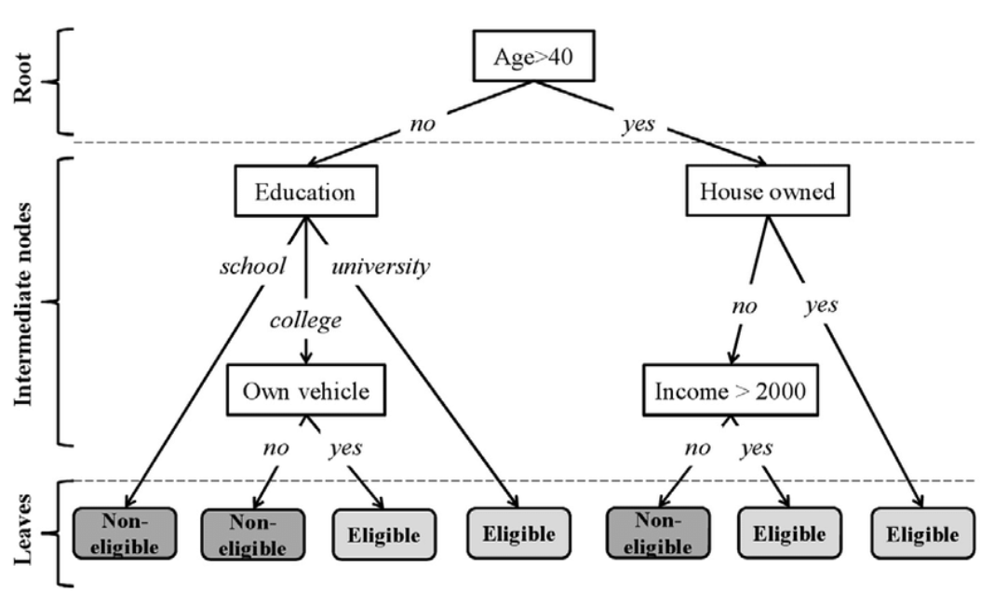
Real life example 1 : Credit Cards eligibility
Banks use multiple criterions to decide if a particular customer is eligible for credit card service or not.
They use historical data to train and test the model. A few examples of criteria could be age, education, income, house owned, etc.
This kind of decision tree model, as shown in the figure, can be created for a dataset to decide the credit card eligibility.

Slide 7
REGRESSION
Regression is a type of supervised machine learning which gives outputs of specific numerical values for an input.
A few examples of outputs which can be generated are ‘x’ dollars, ‘y’ cm, ‘z’ years, etc.
A few fields where this method is used are medical measurements (measuring blood sugar levels, life expectancy), stock price prediction (currency), etc.
Linear regression is a type of regression which plots given datasets into line graphs and then uses this graph to make predictions about new inputs.

Slide 8
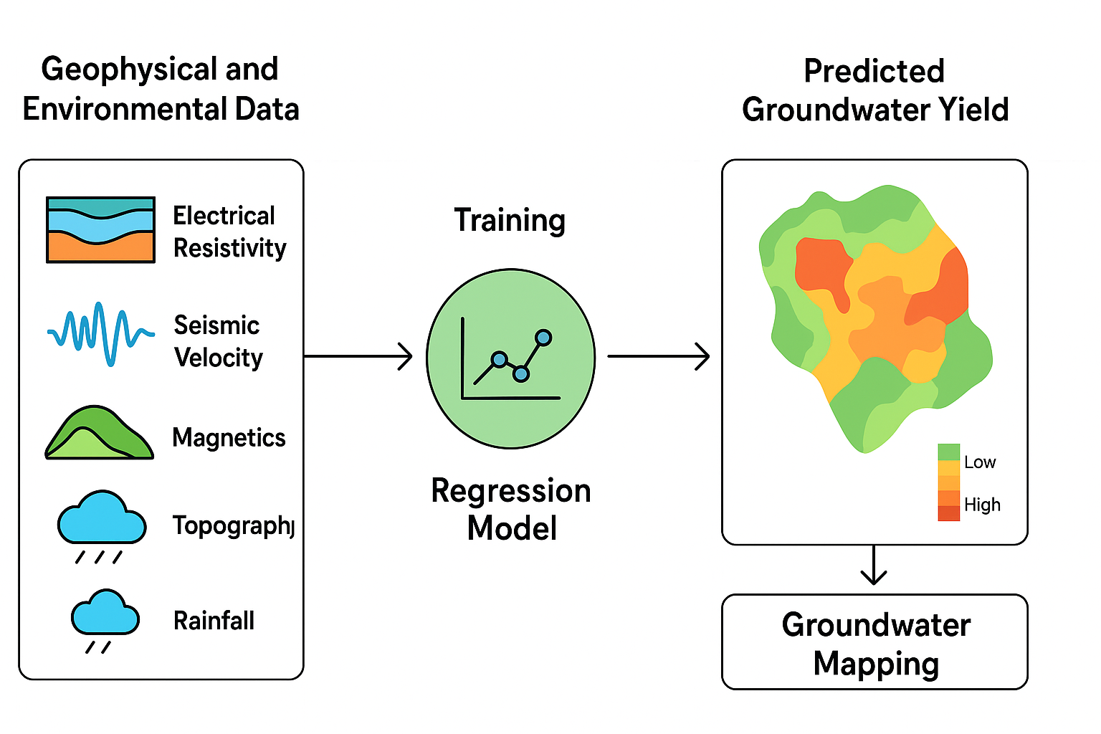
Real life example 2 : In Geophysics
Ground water depth table measured at borehole/wells
Regression model : Y will be continuous variable water table depth (meters)
Features : Electrical Resistivity, Seismic wave speed, magnetic/gravity survey data , topography & Slope details, historical rainfall/recharge data
Once trained, the model can take geophysical survey data from new, unexplored locations and predict Expected water table depth
Saves money & resources by avoiding “dry boreholes" , and also helps manage groundwater sustainably (critical during droughts)

Slide 9
Mathematics of linear regression
The given graph shows a given dataset representing house size v/s the house price. For given house sizes, we have to predict house prices.
The given yellow lines are called residual of a line.
We calculate ∑(residual)^2 for lines of different slopes.
The line with the least sum of residual squares is selected.
Let line be y=mx+c
Let y(avg) be average of house price values and n be number of points.
Y axis : House price (in $)
SS(mean) is sum of squares around mean = (data-mean)^2
Var(mean) is variance around mean = SS(mean)/n
Similarly, SS(fit) and Var(fit) is with the line.
R^2 = Var(mean)-Var(fit)/Var(mean) which tells us how much house size affects house price.
X axis : House size (in sq. ft.)

Slide 10
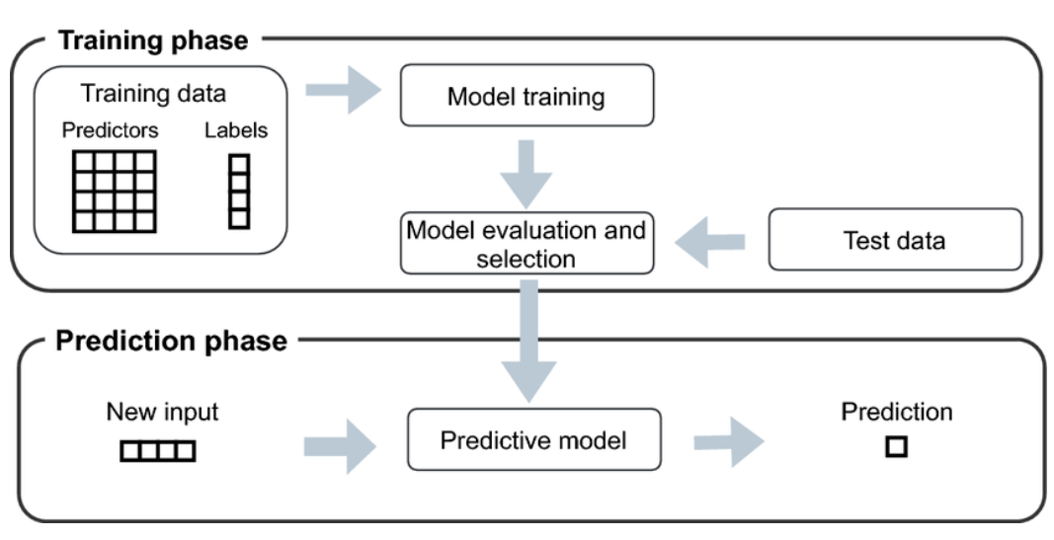
Personal Insights
Supervised learning allows model to learn from past examples
Helps to solve multiple real world problems ranging from spam detection, medical diagnosis to sales forecasting.
With the help of a large dataset, supervised learning can be a very accurate method for predicting outputs.
But at the same time, supervised learning can be time consuming, it’s success depends on the quality and quantity of labelled data and is prone to overfitting.
Despite these limitations, supervised learning remains a foundational technique in machine learning, offering a clear and structured way to map inputs to outputs and drive intelligent decision-making in diverse fields.

Slide 11


